Slide 1
Dependent Student Invites Parent

Slide 2
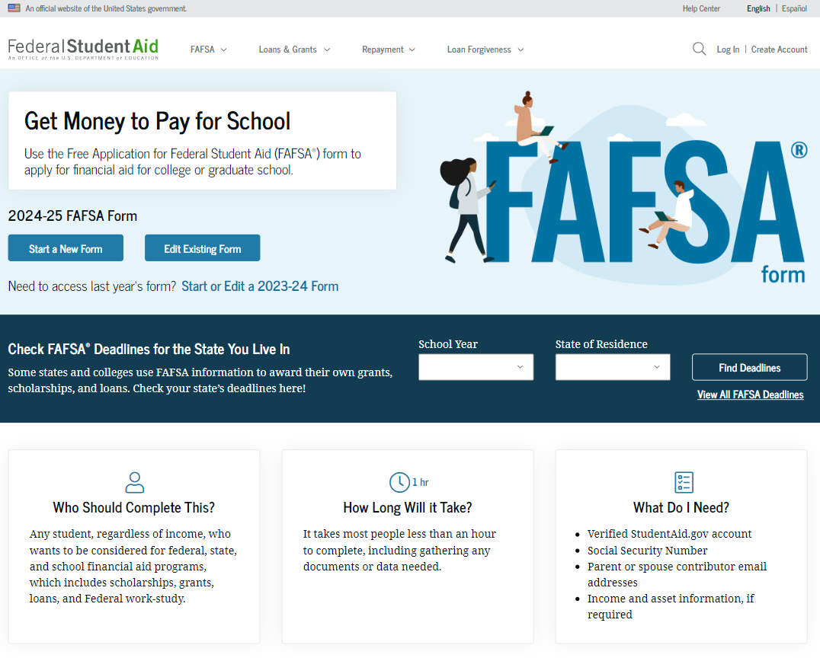
Dependent Student FAFSA® Form Landing Page
This is the main FAFSA® form landing page. On this page, students are directed to "Start a New Form" or "Edit Existing Form." For the purpose of this presentation, the student is beginning a new application.

Slide 3
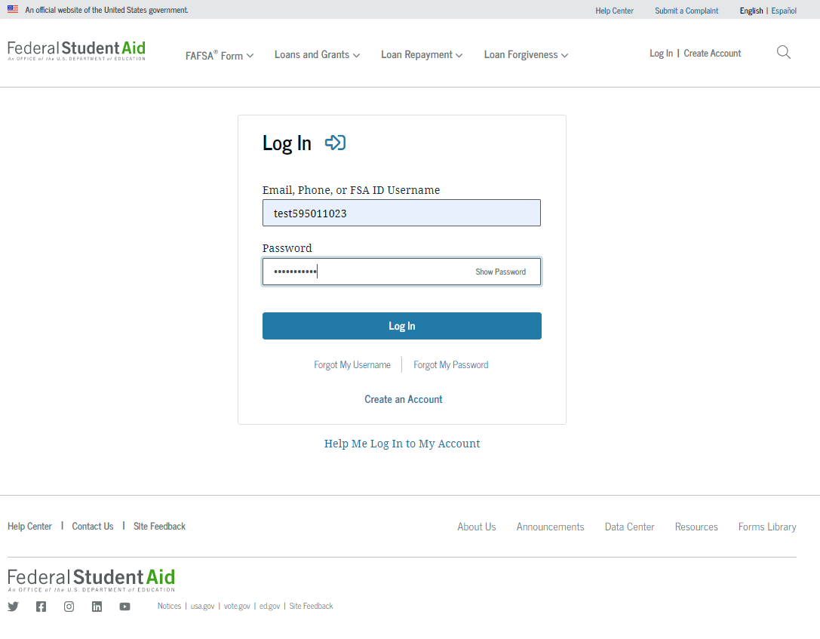
Dependent Student Log In
If the student selects "Start a New Form" from the FAFSA® landing page and they are not logged in to StudentAid.gov, they are taken to the “Log In” page to enter their log-in credentials. To access the FAFSA form, all students are required to have an FSA ID (account username and password). If the student doesn't have an FSA ID, they can select "Create an Account."

Slide 4
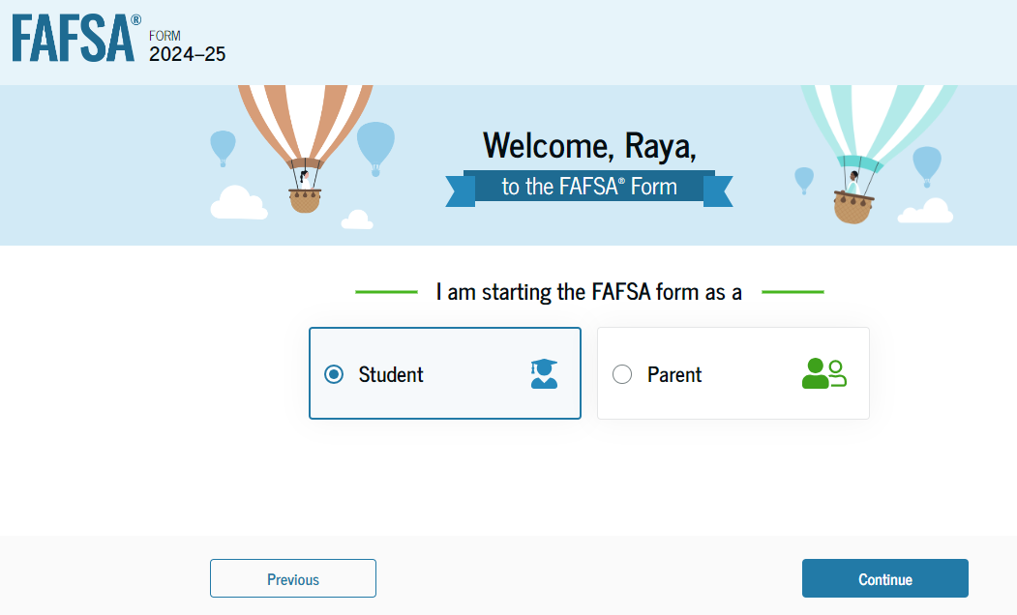
Dependent Student Roles
After logging in, the student can select the applicable role to fill out the FAFSA® form: “Student,“ or "Parent.“ The student selects “Student."

Slide 5
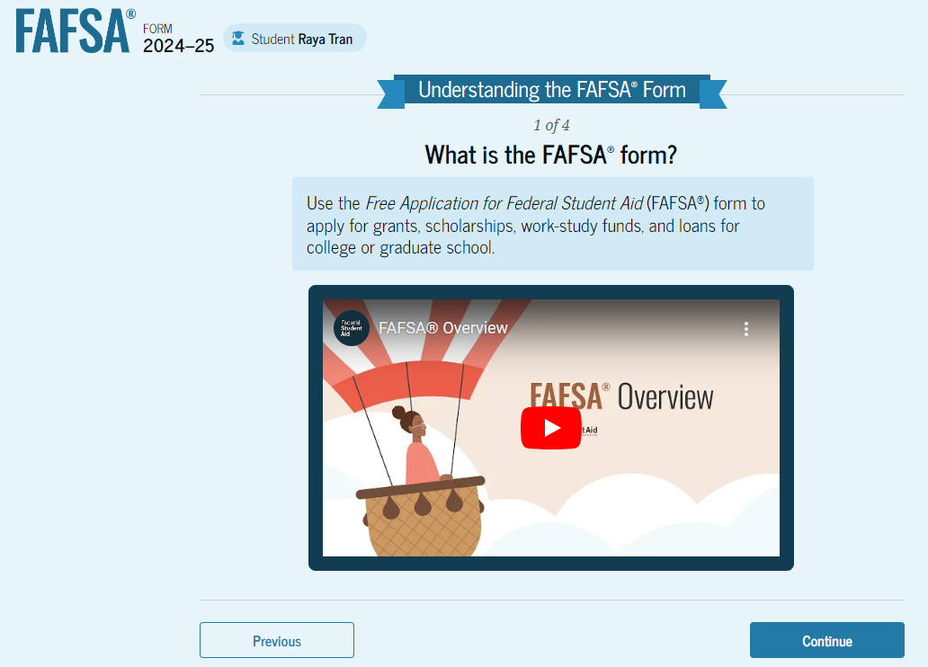
Student Onboarding (1 of 4)
When the student starts the 2024–25 FAFSA® form for the first time, they are taken through the FAFSA onboarding process. The first onboarding page provides an overview of the FAFSA form and an accompanying video.

Slide 6
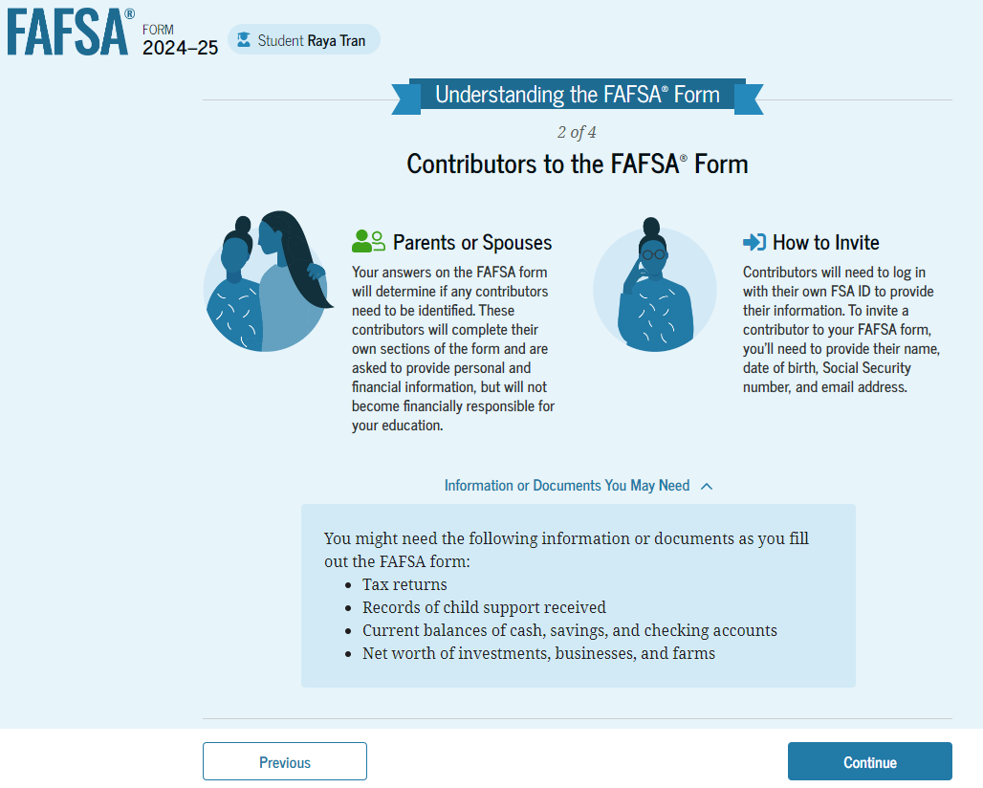
Dependent Student Onboarding (2 of 4)
The second FAFSA® onboarding page provides information about the different roles that may be required to participate in the student’s FAFSA form and documents that may be needed to fill out the form.

Slide 7
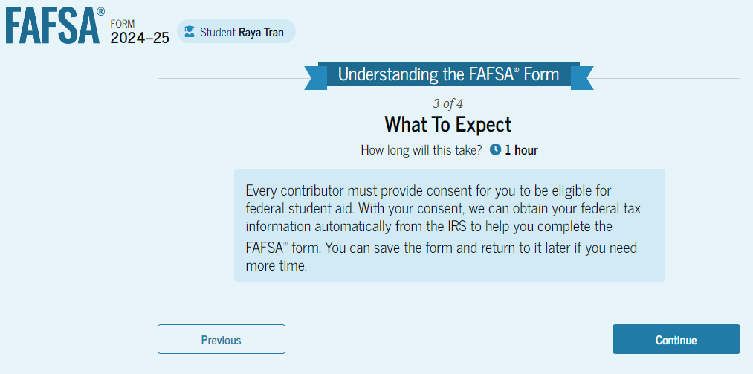
Dependent Student Onboarding (3 of 4)
The third FAFSA® onboarding page provides information about the types of questions the student can expect to see and how they can get additional help with filling out the FAFSA form.

Slide 8
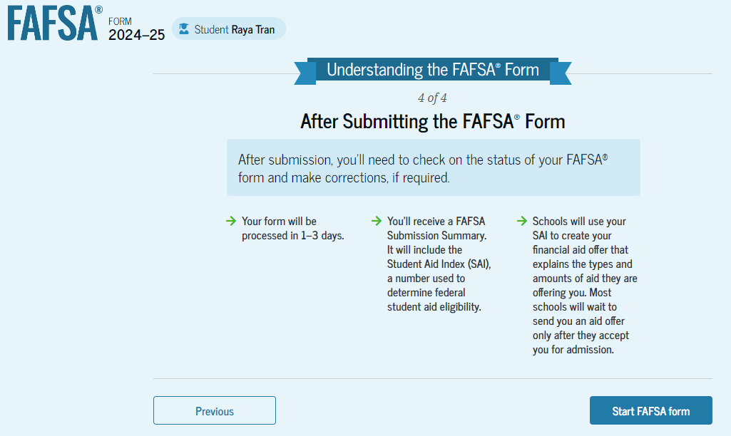
Dependent Student Onboarding (4 of 4)
The last FAFSA® onboarding page provides information about what to expect once the FAFSA form is completed and submitted. On this page, the student can select "Start the FAFSA form" to begin.

Slide 9
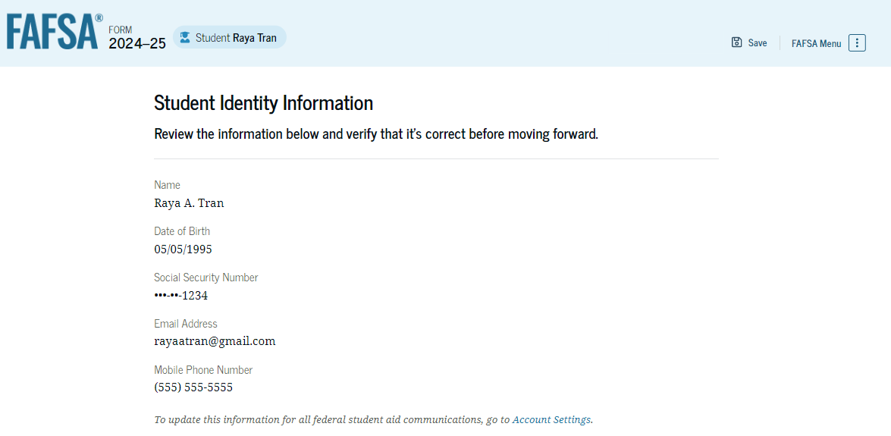
Dependent Student Identity Information
This is the first page within the student section. The student can verify that their personal information is correct. To update any of the personal information, the student must access their Account Settings on StudentAid.gov. For fields related to the student’s mailing address, the student can edit them directly on this page.

Slide 10
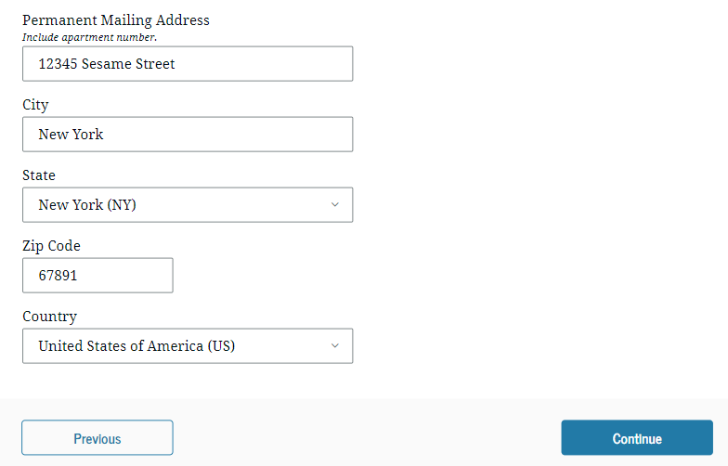
Dependent Student Identity Information (Continued)

Slide 11
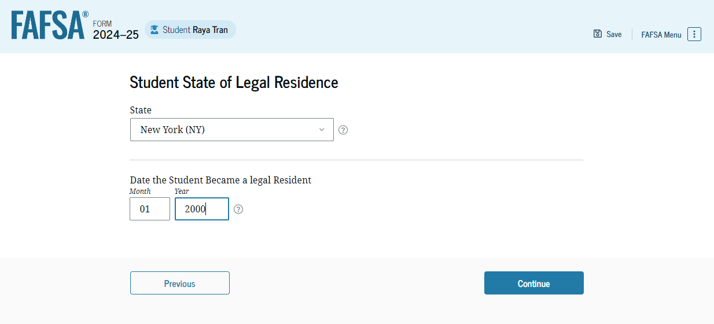
Dependent Student State of Legal Residence
The student is asked about their state of legal residence. The student selects the state from a dropdown box and provides the month and year when they became a legal resident.

Slide 12
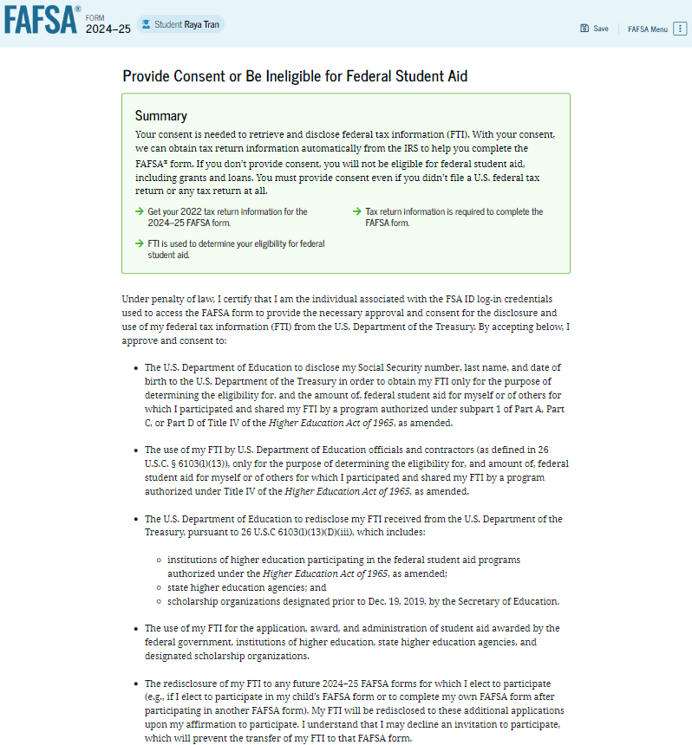
Dependent Student Provides Consent
This page informs the student about consent and their federal tax information. By providing consent, the student’s federal tax information is transferred directly into the FAFSA® form from the IRS to help complete the Student Financials section. The student selects "Approve" to provide consent and is taken to the next page.

Slide 13
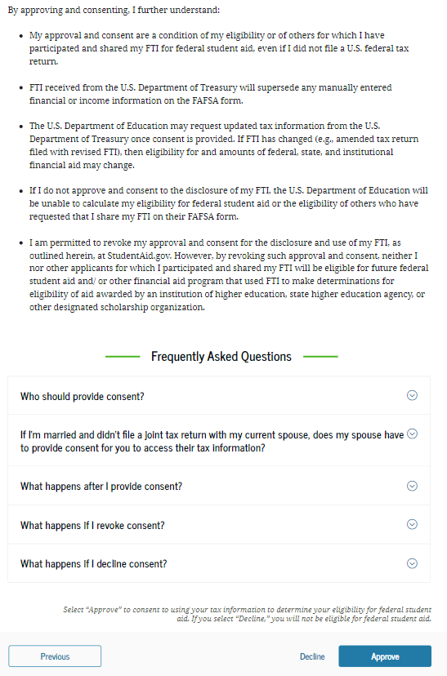
Dependent Student Provides Consent (Continued)

Slide 14
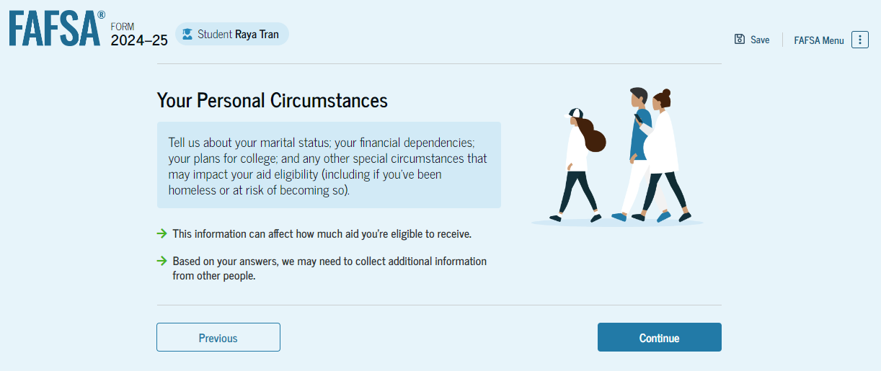
Introduction: Dependent Personal Circumstances
This is the first page within the Student Personal Circumstances section. It provides an overview of the section.

Slide 15
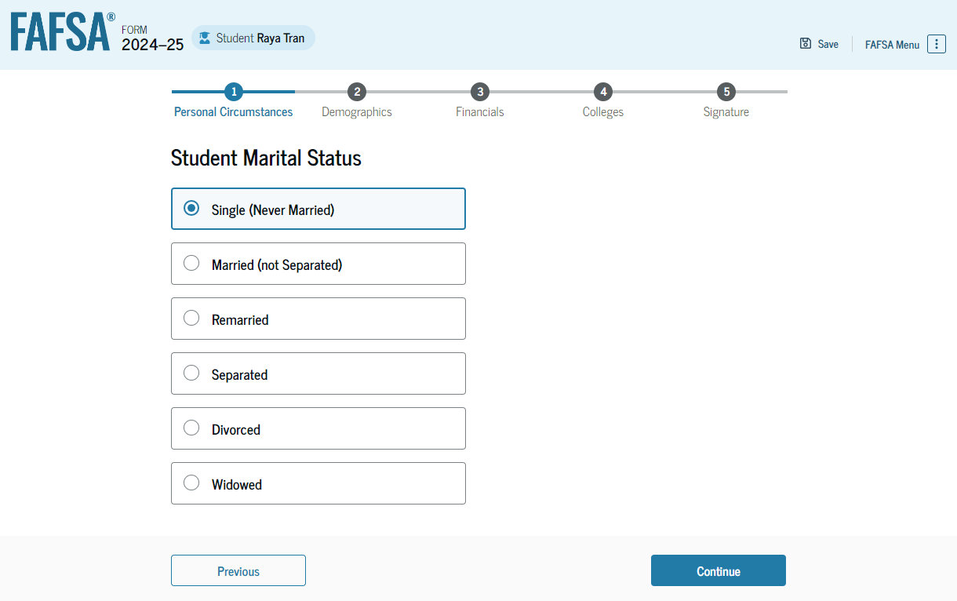
Dependent Student Marital Status
The student is asked about their marital status. The student selects the "Single (Never Married)" option.

Slide 16
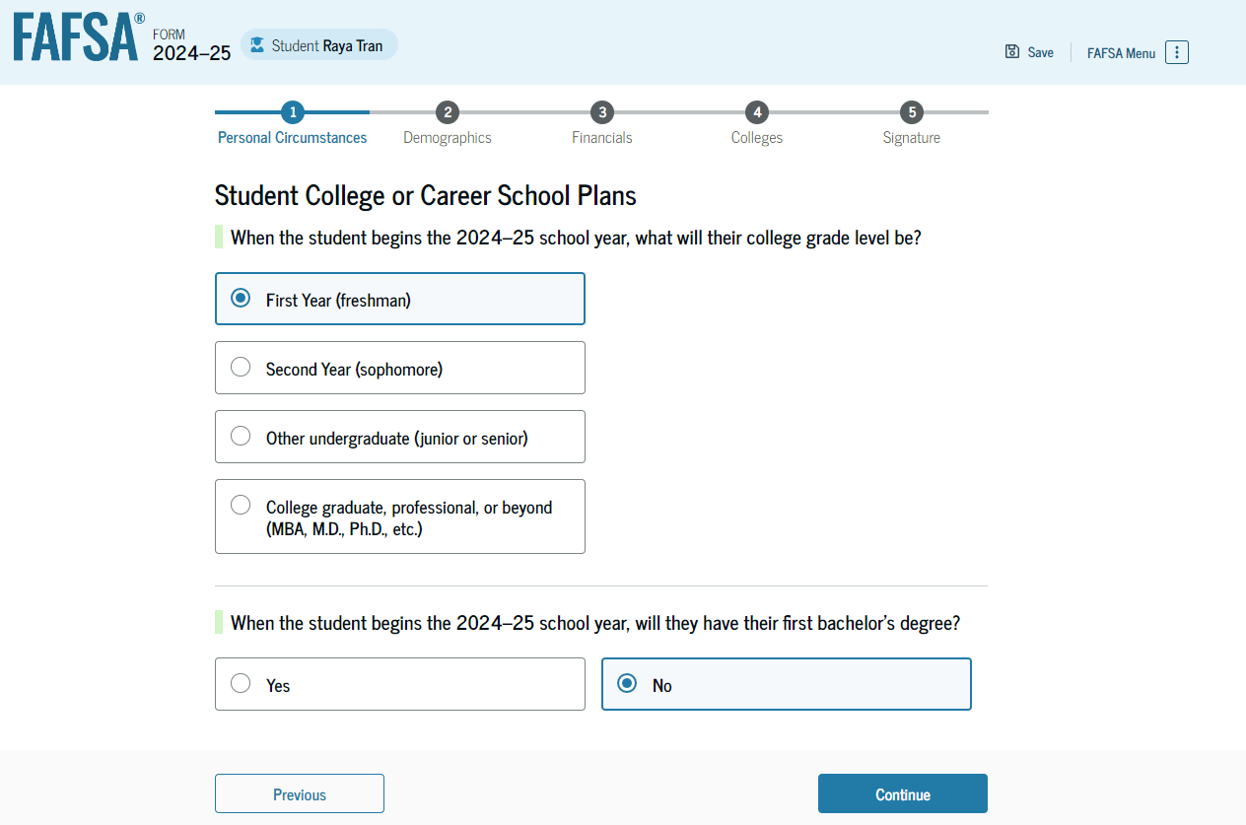
Dependent Student College or Career School Plans
The student is asked about their college grade level for the 2024–25 school year and if they will have their first bachelor’s degree. The student selects that they will be a "First Year (freshman)" and that they will not have their first bachelor’s degree.

Slide 17
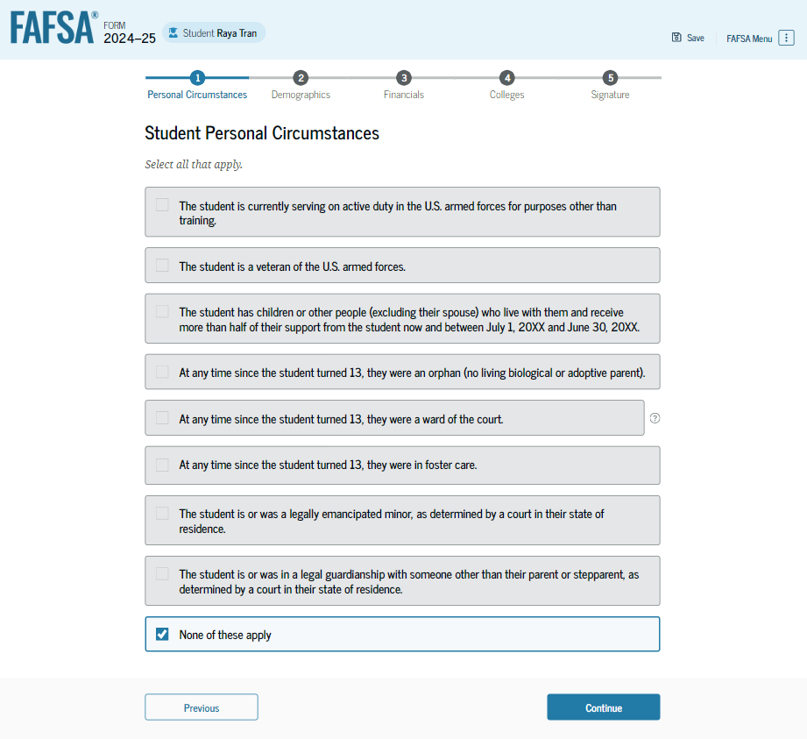
Dependent Student Personal Circumstances
The student is asked if any of the listed personal circumstances apply to them. The student selects the "None of these apply" option.

Slide 18
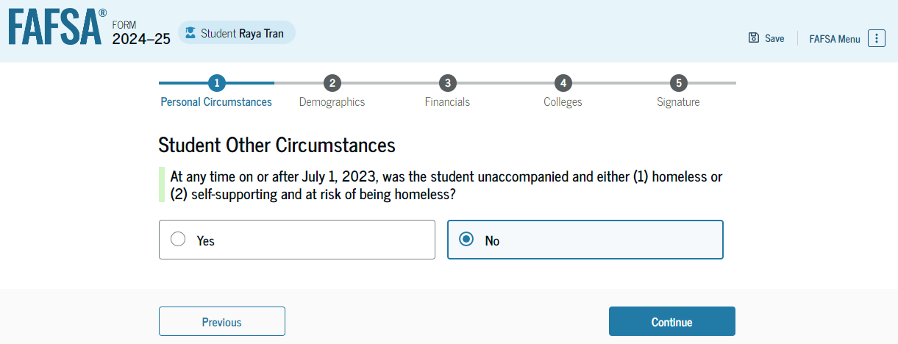
Dependent Student Other Circumstances
The student is asked if they were homeless or at risk of being homeless. The student selects "No."

Slide 19
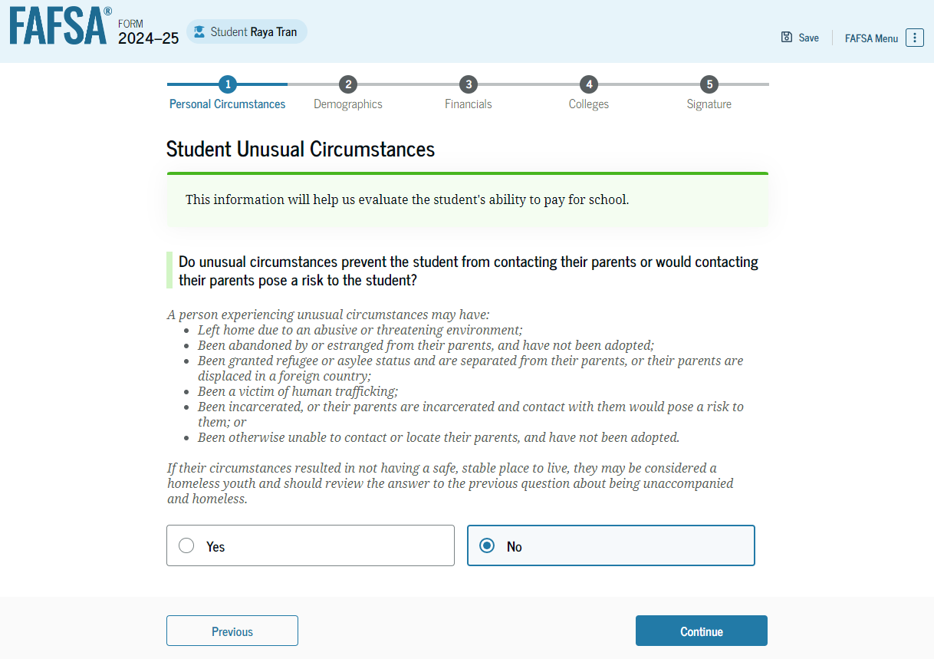
Dependent Student Unusual Circumstances
The student is asked if unusual circumstances prevent them from contacting their parent(s). The student selects "No."

Slide 20
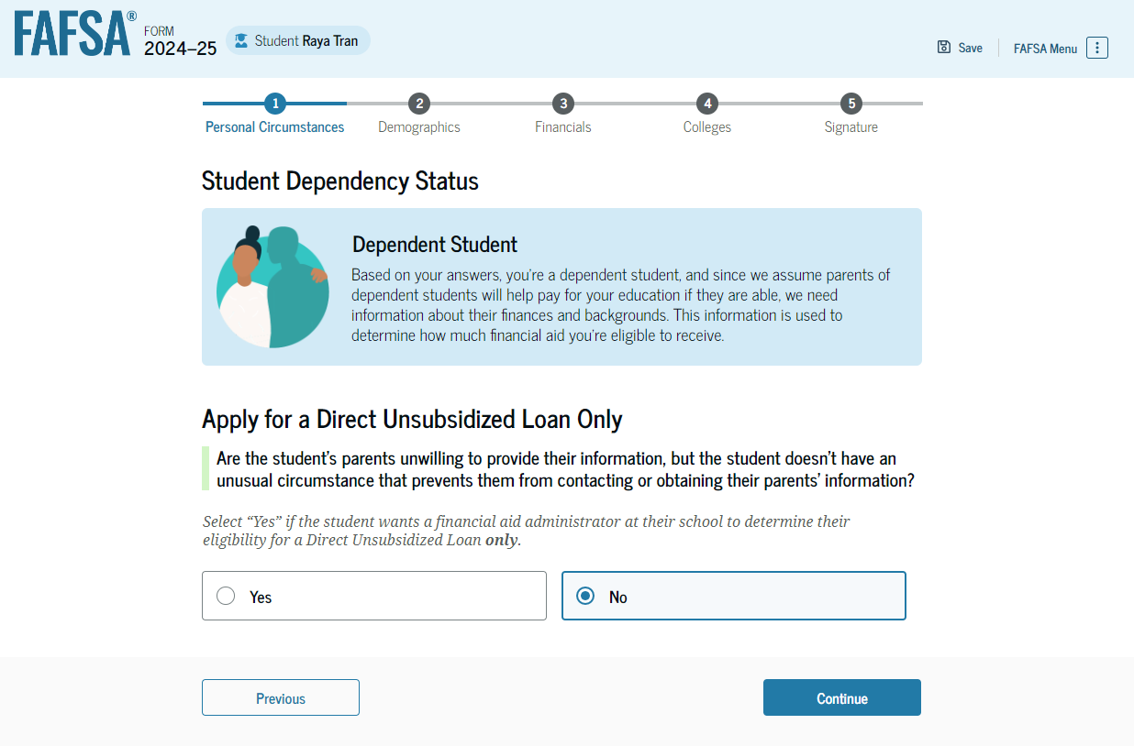
Student Dependency Status: Dependent Student
Based on the answers provided by the student, they are considered a dependent student. The student is asked if they want a financial aid administrator to determine their eligibility for a Direct Unsubsidized Loan only. This is an option if the student’s parents are unwilling to provide information. The student selects "No."

Slide 21
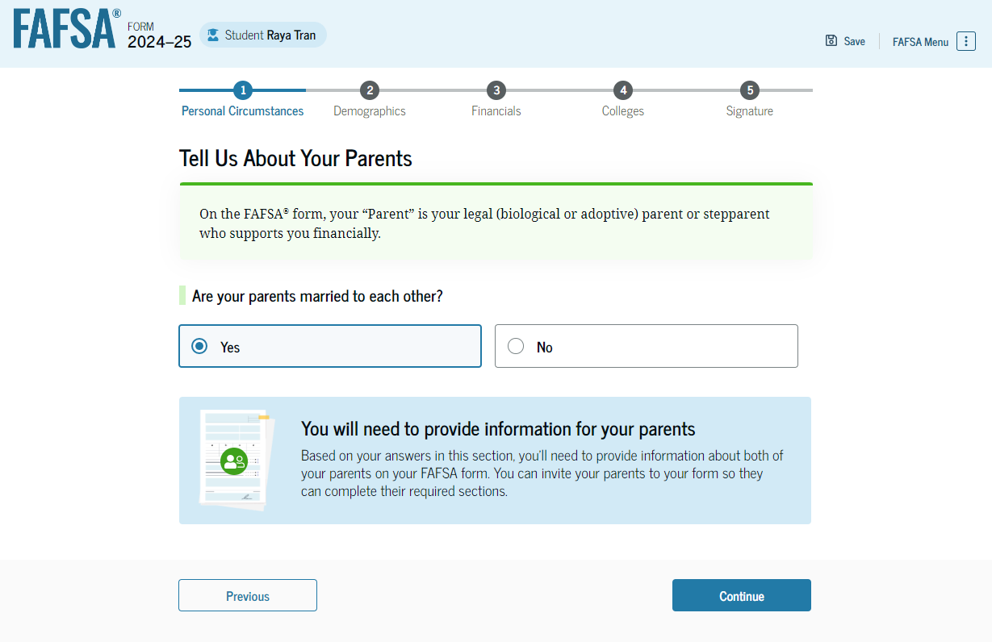
Dependent Student: Tell Us About Your Parents
As the student is considered dependent, they are asked to provide information about their parents. The FAFSA® form considers their “Parent” to be their legal (biological or adoptive) parent. The student is asked if their parents are married. The student selects "Yes" and is required to invite their parents to their FAFSA form to complete the required parent sections.

Slide 22
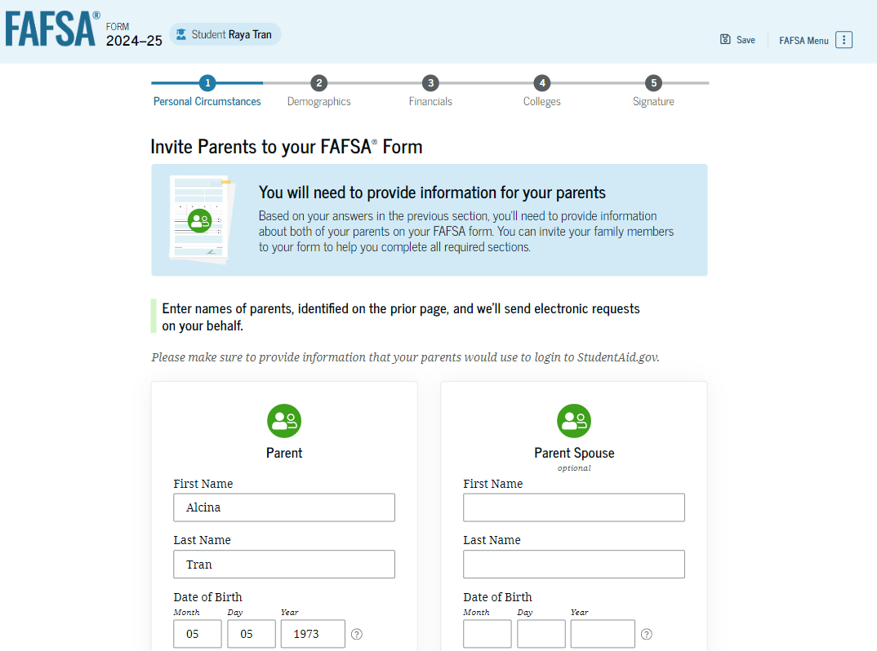
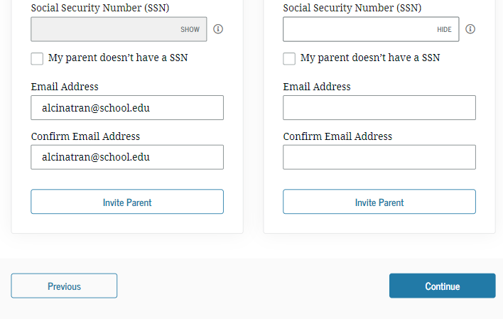
Dependent Student Invites Parents to FAFSA® Form
The student is asked to enter personal information about their parents in order to send them an invite to their FAFSA® form. In this scenario, the student invites one parent.

Slide 23
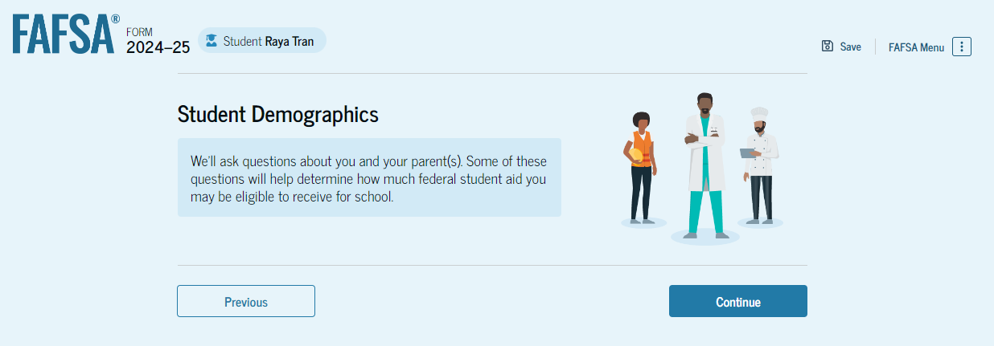
Introduction: Dependent Student Demographics
This is the first view within the Student Demographics section. It provides an overview of the section.

Slide 24
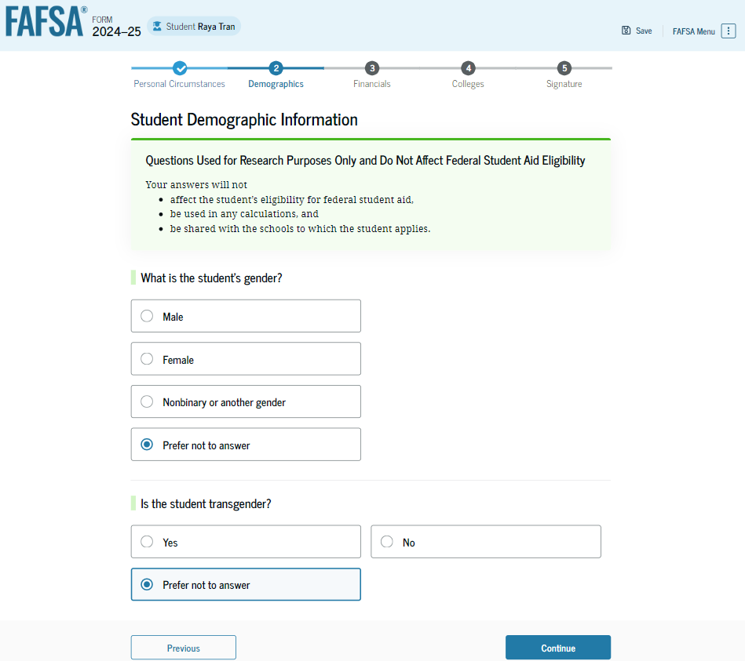
Dependent Student Demographic Information
The student is asked about their gender identity and if they are transgender. The student selects their response from the options for both questions.

Slide 25
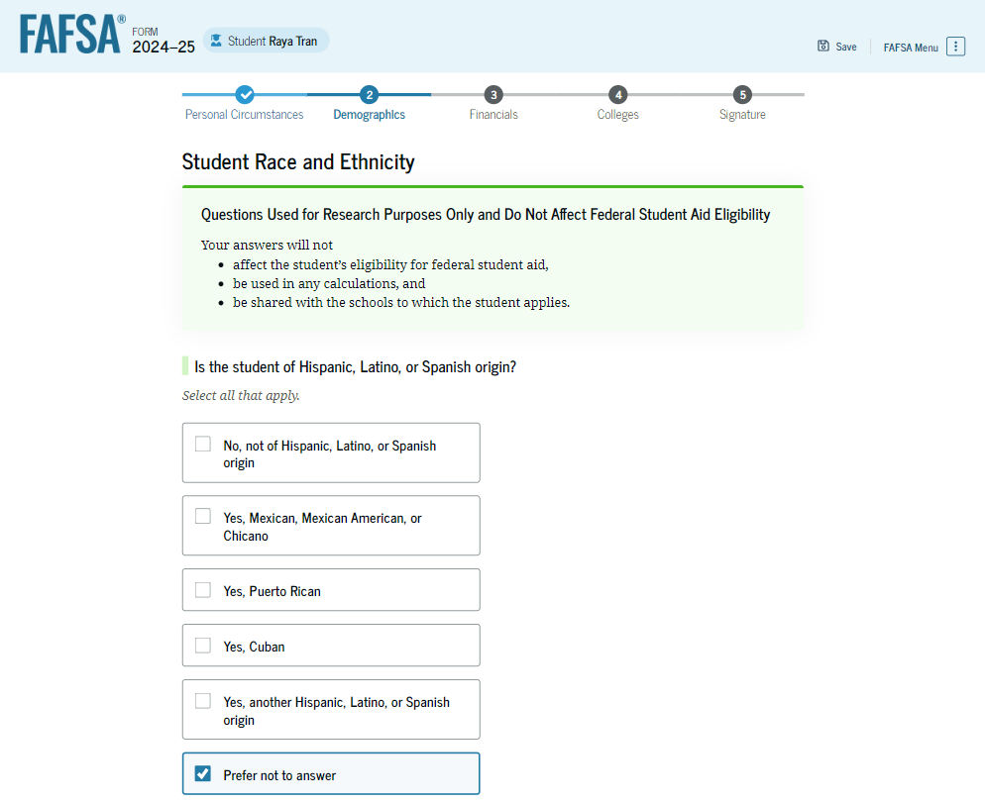
Dependent Student Race and Ethnicity
The student is asked if they are of Hispanic, Latino, or Spanish origin. They are also asked about their race. The student selects checkboxes to answer both questions.

Slide 26
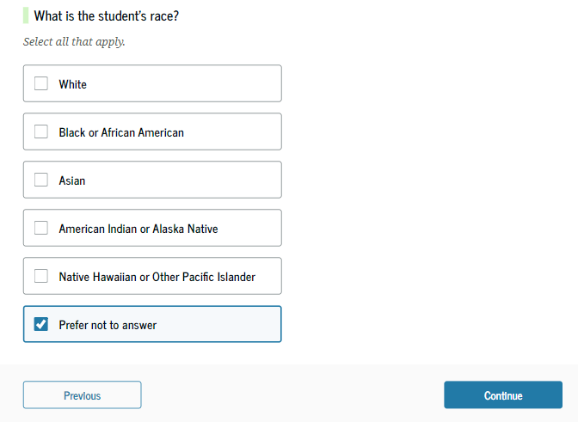
Dependent Student Race and Ethnicity (Continued)

Slide 27
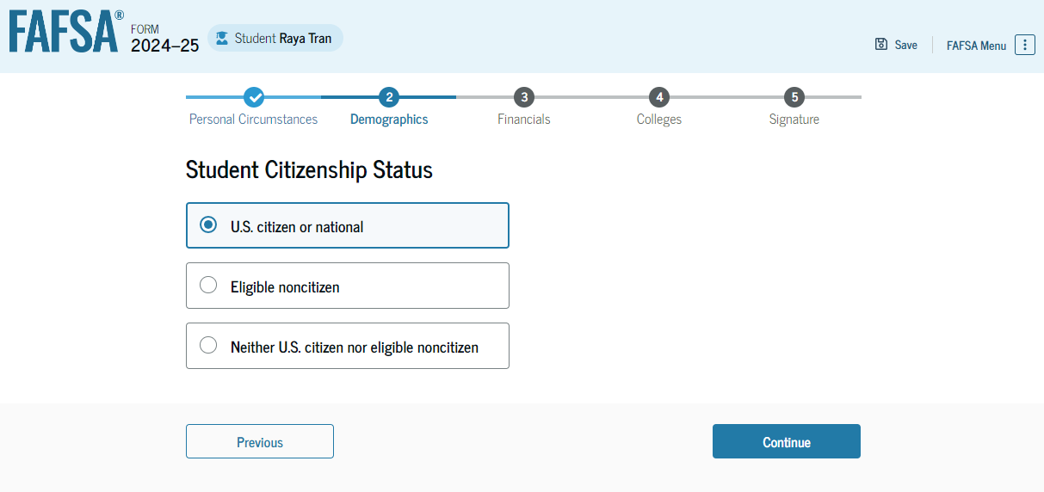
Dependent Student Citizenship Status
The student is asked about their citizenship status. The student selects the "U.S. citizen or national" option.

Slide 28
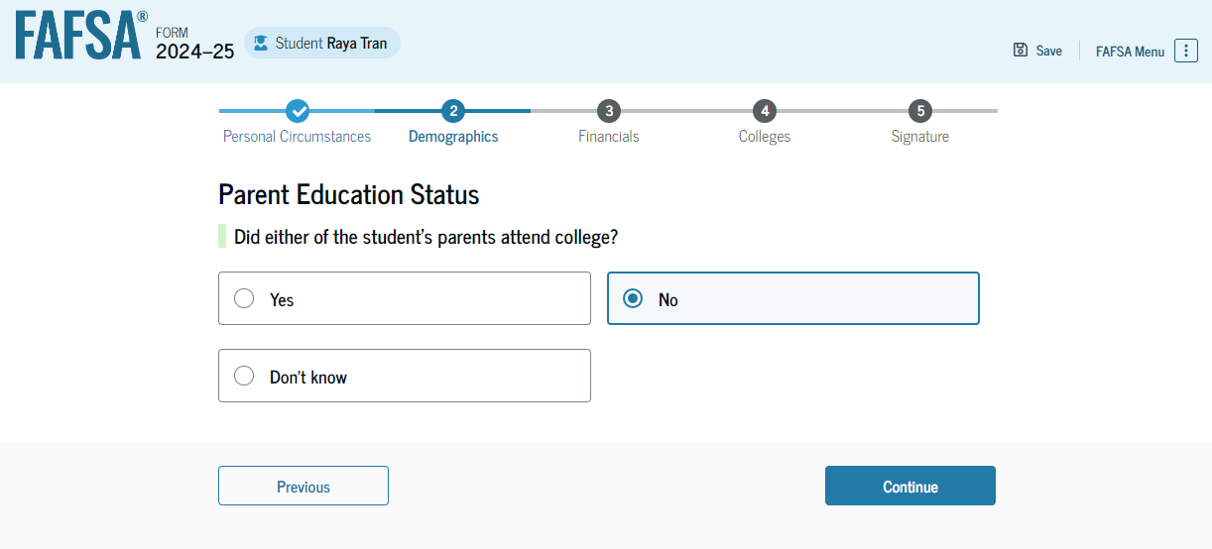
Dependent Student’s Parent Education Status
The student is asked about their parents’ education status. The student selects the “No” option.

Slide 29
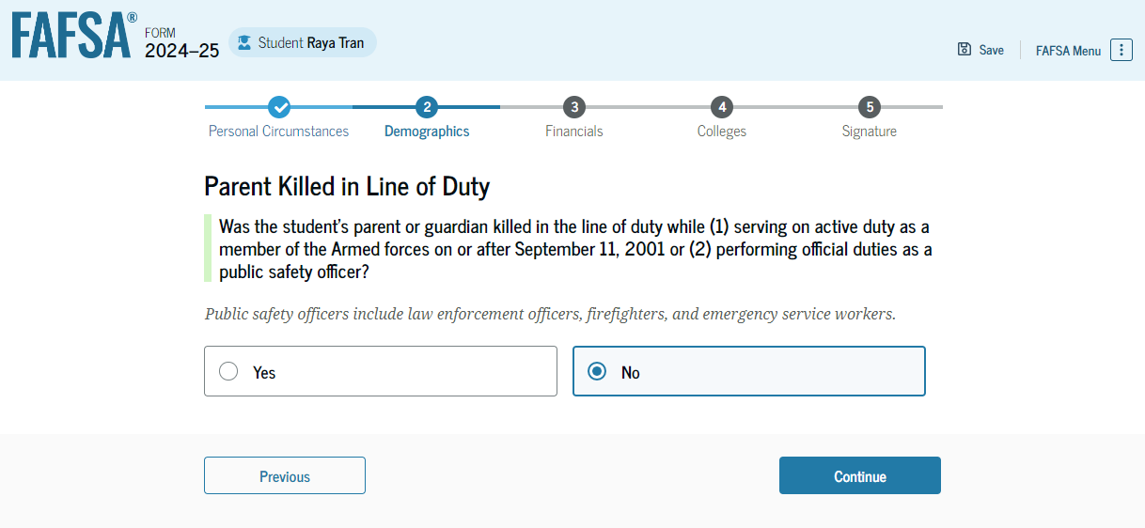
Dependent Student’s Parent Killed in Line of Duty
The student is asked if their parent was killed in the line of duty. The student selects the “No” option.

Slide 30
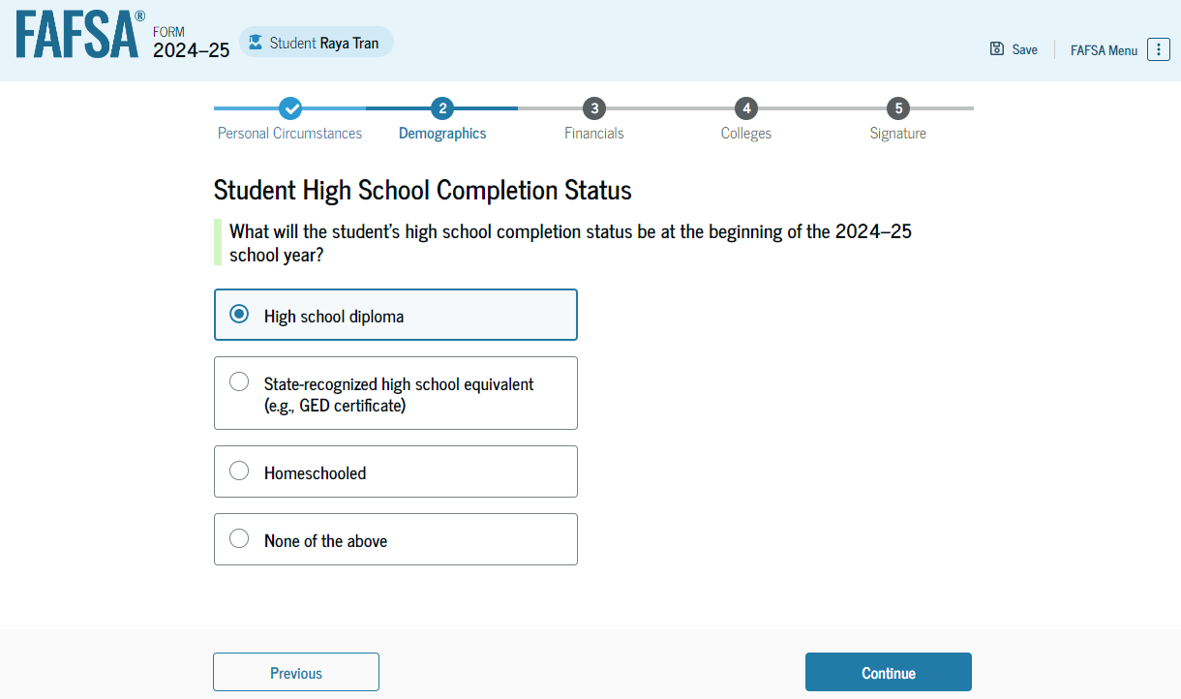
Dependent Student High School Completion Status
The student is asked about what their high school completion status will be when they start the 2024–25 school year. The student selects the "High school diploma" option.

Slide 31
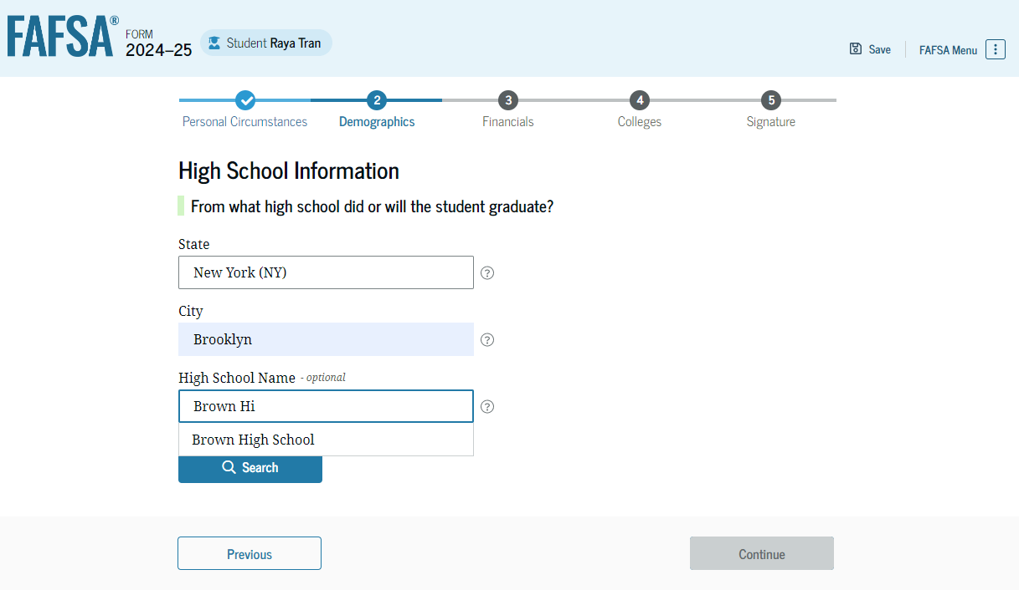
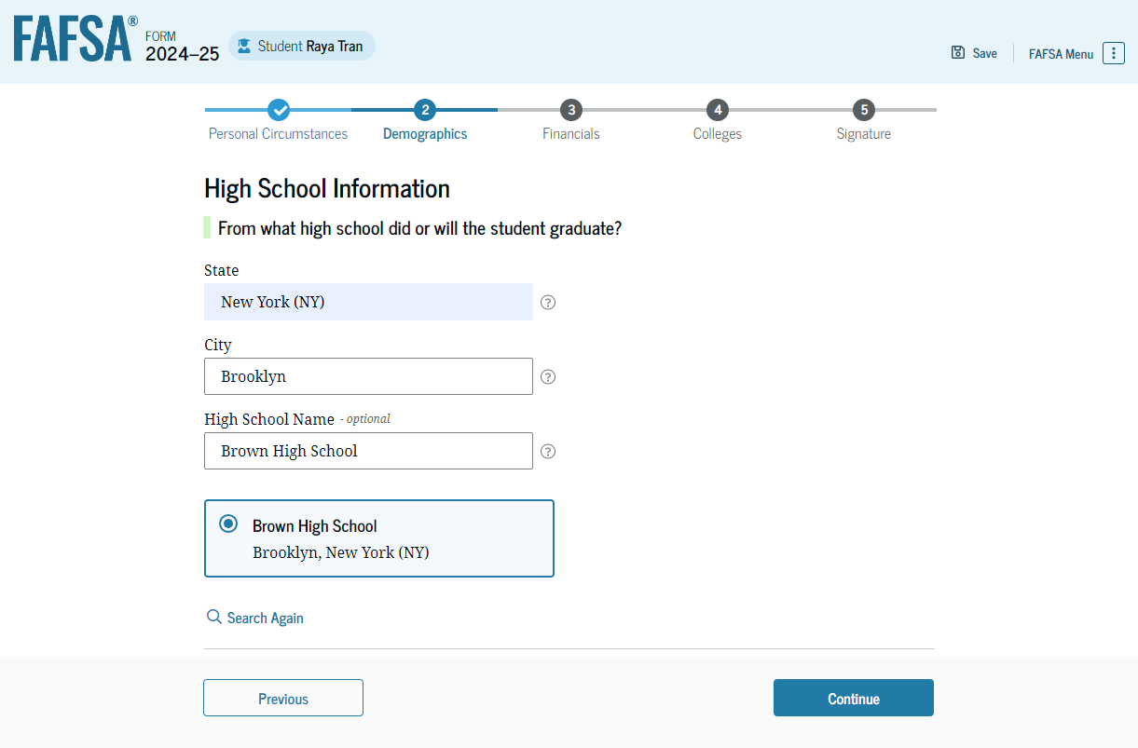
Dependent Student High School Information
The student is asked which high school they did or will graduate from. The student enters their high school’s state and city. After selecting "Search," they select the correct high school from the search results.

Slide 32
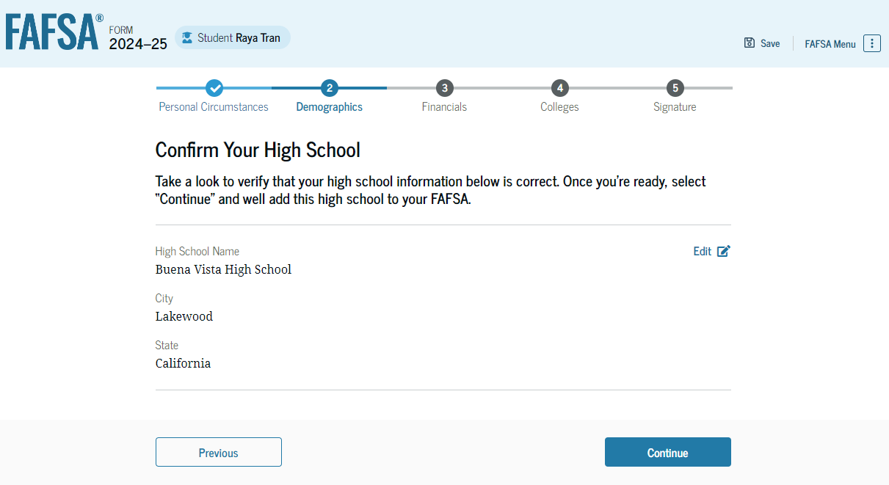
Dependent Student Confirms High School
The student has the option to edit the high school information presented on this page by selecting "Edit," which will return them to the high school information page. The student confirms their high school information and selects "Continue" to proceed to the next section.

Slide 33
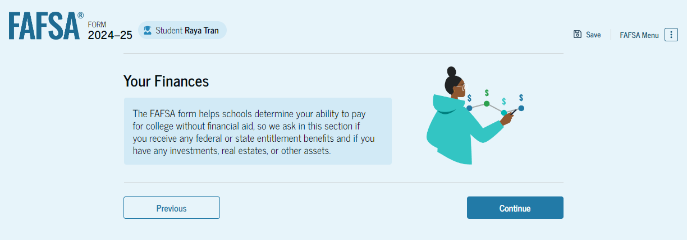
Introduction: Dependent Student Financials
This is the first page within the Student Financials section. It provides an overview of the section.

Slide 34
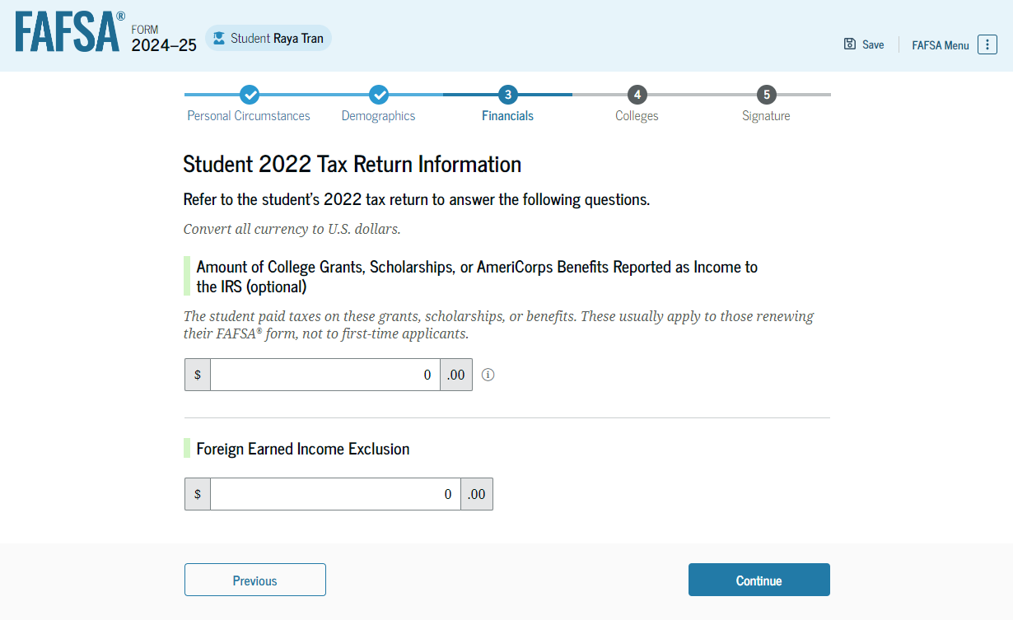
Dependent Student Tax Return Information
The student is asked questions about their 2022 tax return. The student enters a response in each entry field.

Slide 35
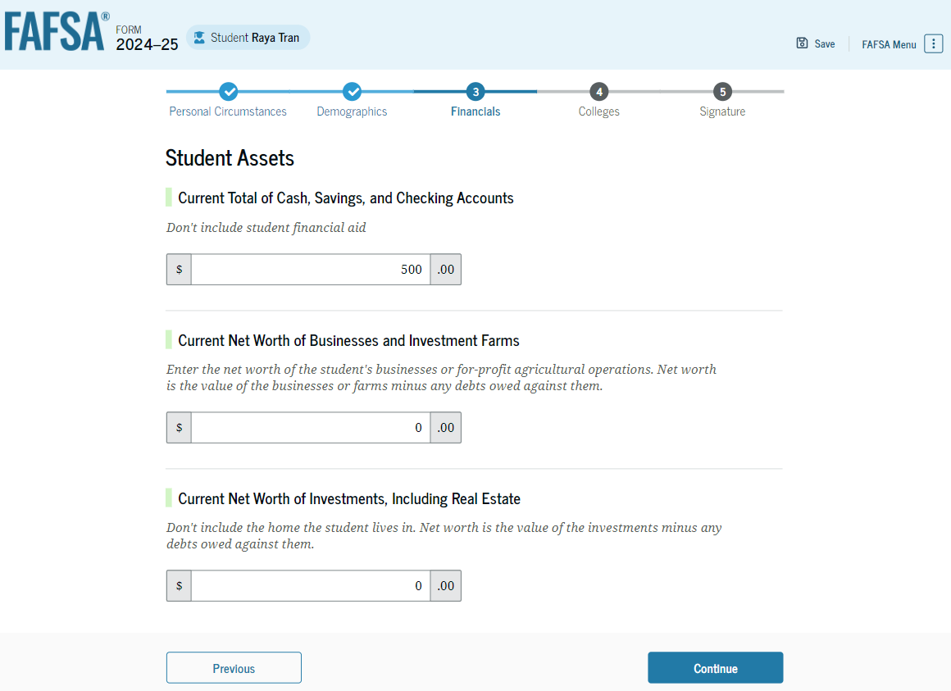
Dependent Student Assets
The student is asked about their assets. The student enters a response in each entry field.

Slide 36
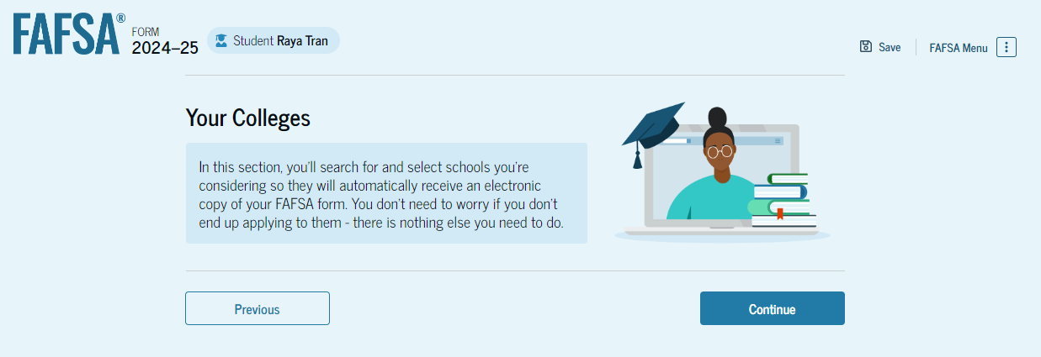
Introduction: Dependent Student Select Colleges
This is the first page in the Select Colleges section, which is the final part of the FAFSA® form’s student section to require information. It provides an overview of the section.

Slide 37
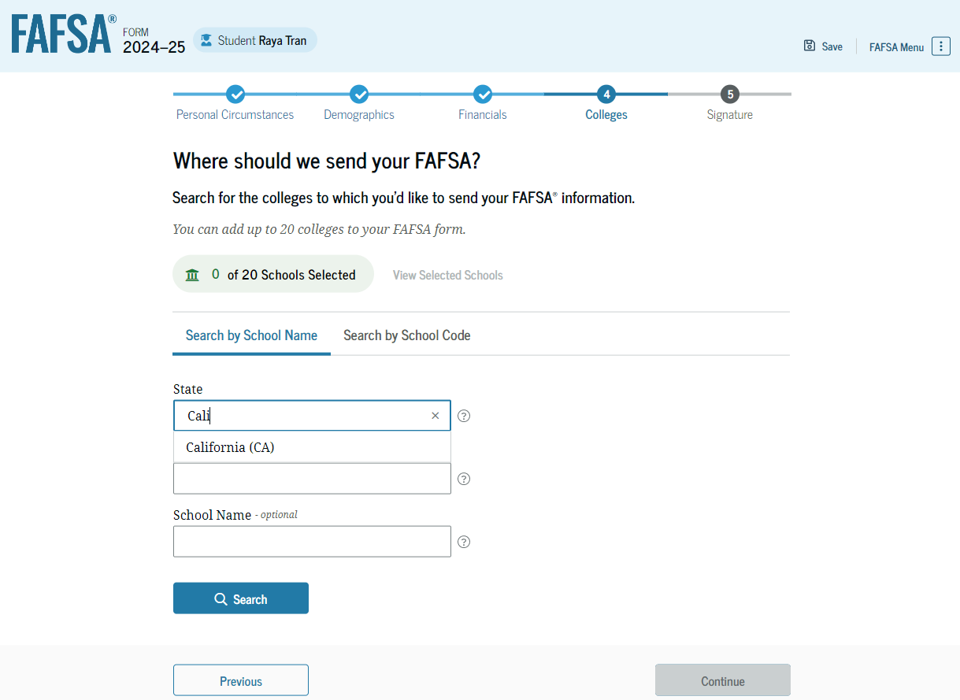
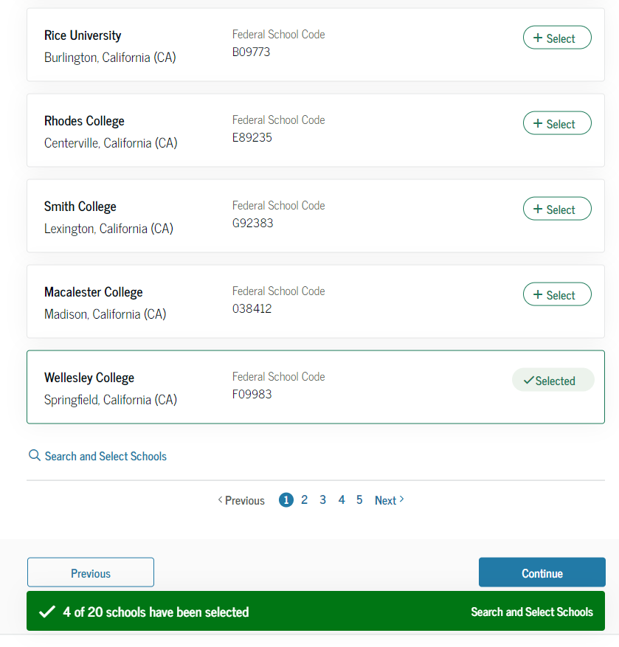
Dependent Student College Search
The student is asked to search for the colleges and/or career schools they would like to receive their FAFSA® information. The student searches for a school by entering a state, city, and/or school name. After selecting "Search," they select the correct school from the search results. Students can select to send their FAFSA information to a maximum of 20 schools.

Slide 38
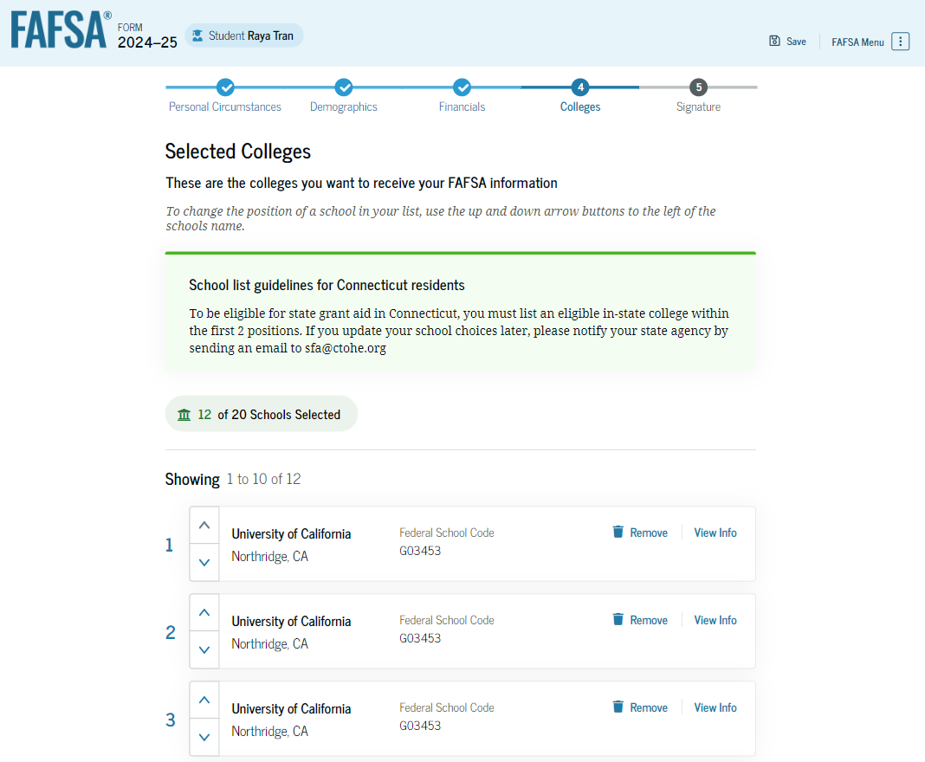
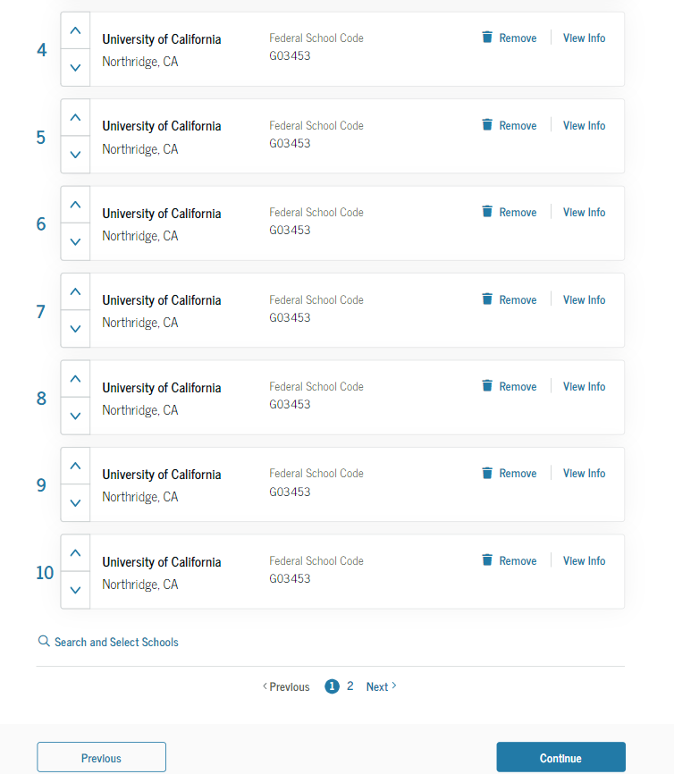
Dependent Student Selected Colleges
The student can view which colleges and/or career schools they have selected. If the student has not selected 20 schools, they have the option to search and select more schools, and for students in some states, they have the option to change the position of their selected schools. When the student selects "Continue," they will have completed entering the required student information for their section and can proceed to review and sign their form.

Slide 39
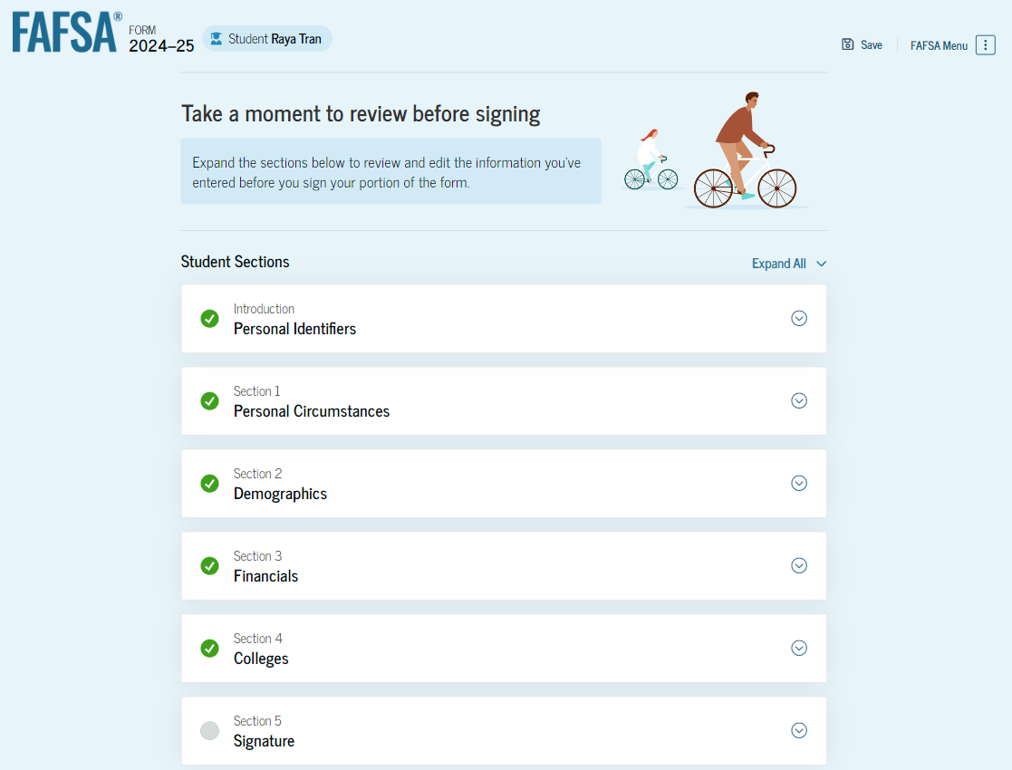
Dependent Student Review Page
The review page displays the responses that the student has provided in the FAFSA® form. The student can view all their responses by selecting "Expand All" or expand each section individually. To edit a response, the student can select the question’s hyperlink and will be taken to the corresponding page. Additionally, since the student invited their parent into the form, they see the parent contributor section and the status of their parent’s invite.

Slide 40
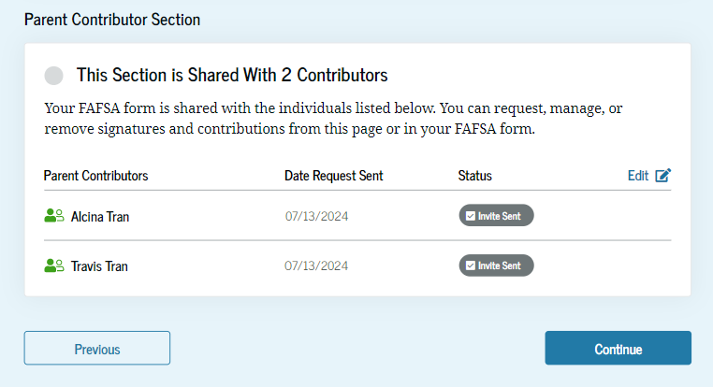
Dependent Student Review Page (Continued)

Slide 41
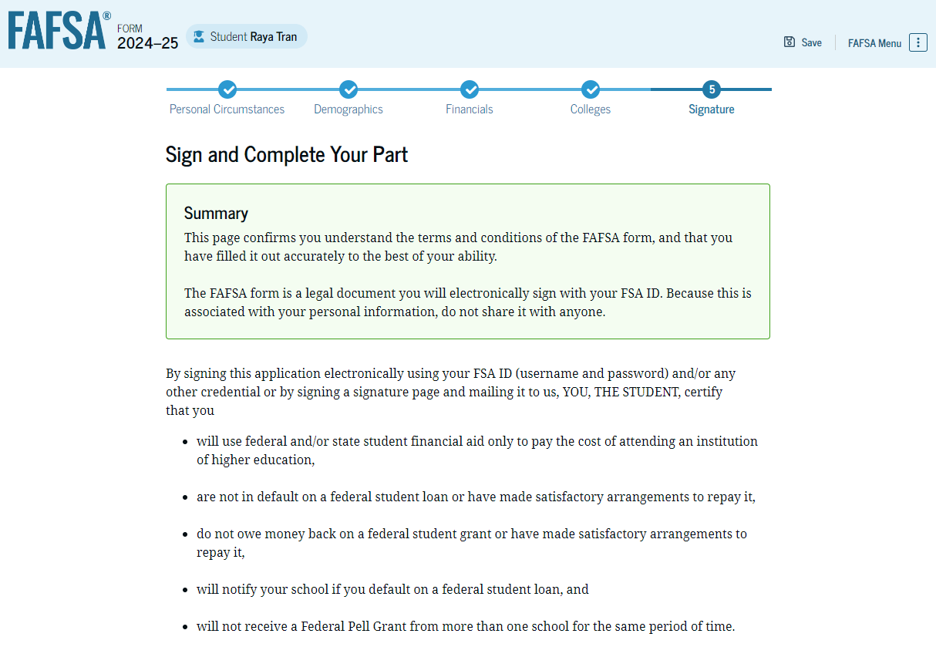
Dependent Student Signature
On this page, the student acknowledges the terms and conditions of the FAFSA® form and signs their section. After agreeing and signing, the student is able to submit their section of the FAFSA form. Since parent information has not been provided, the FAFSA form is not considered complete and can’t be processed yet.

Slide 42
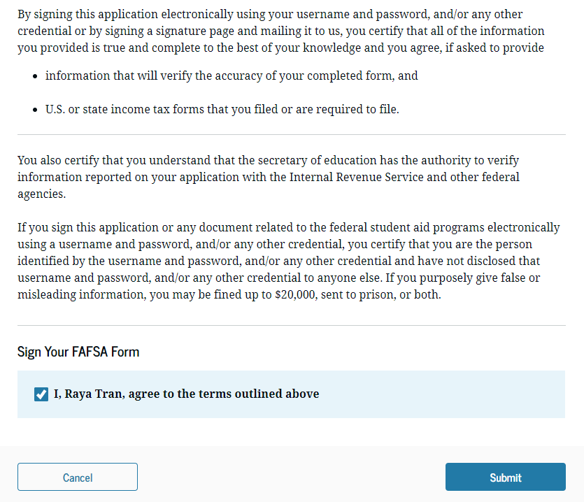
Dependent Student Signature (Continued)

Slide 43
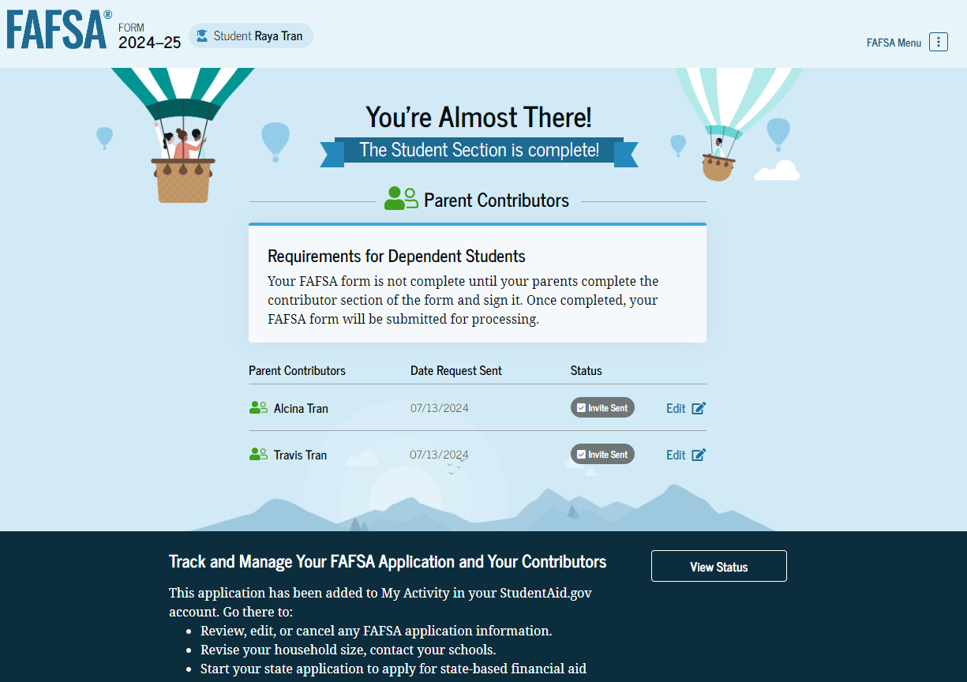
Dependent Student Section Complete
Upon signing the student section, the student is presented the student section complete page. This page displays information for the student about next steps, including tracking their FAFSA® form. The student is reminded that their form is not completed and can’t be submitted until the parent completes the contributor section of the form and signs it. Next, in this scenario, the student’s invited parent will enter the FAFSA form and complete the parent section.

Slide 44
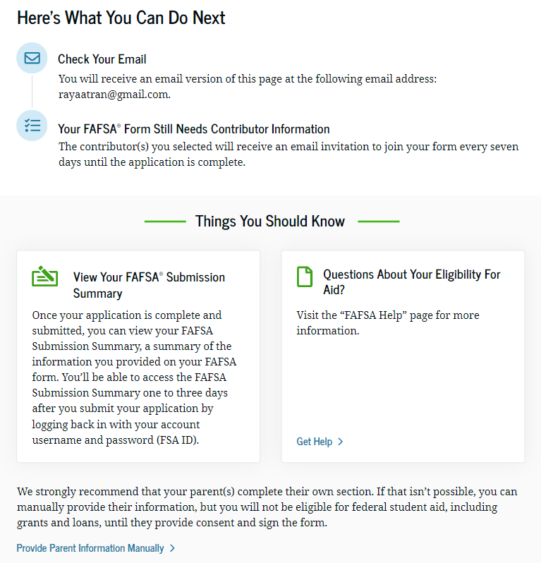
Dependent Student Section Complete (Continued)

Slide 45
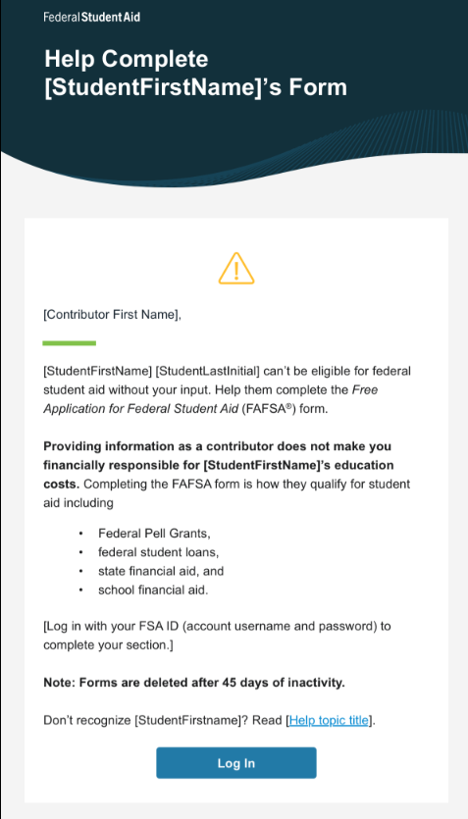
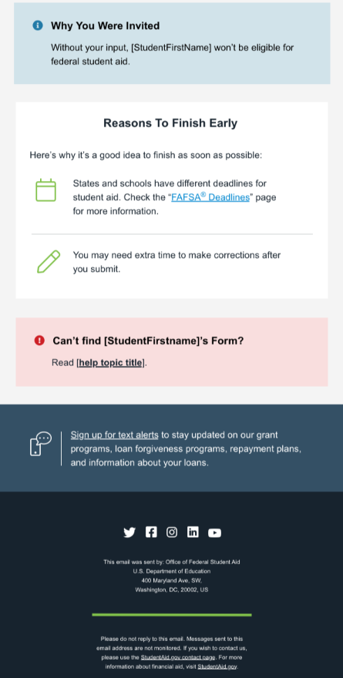
Dependent Student’s Parent Email
This is NOT a view within StudentAid.gov nor the FAFSA® form. This view demonstrates a parent opening the FAFSA invitation from their email. The parent selects “Log In" and is taken to StudentAid.gov.

Slide 46
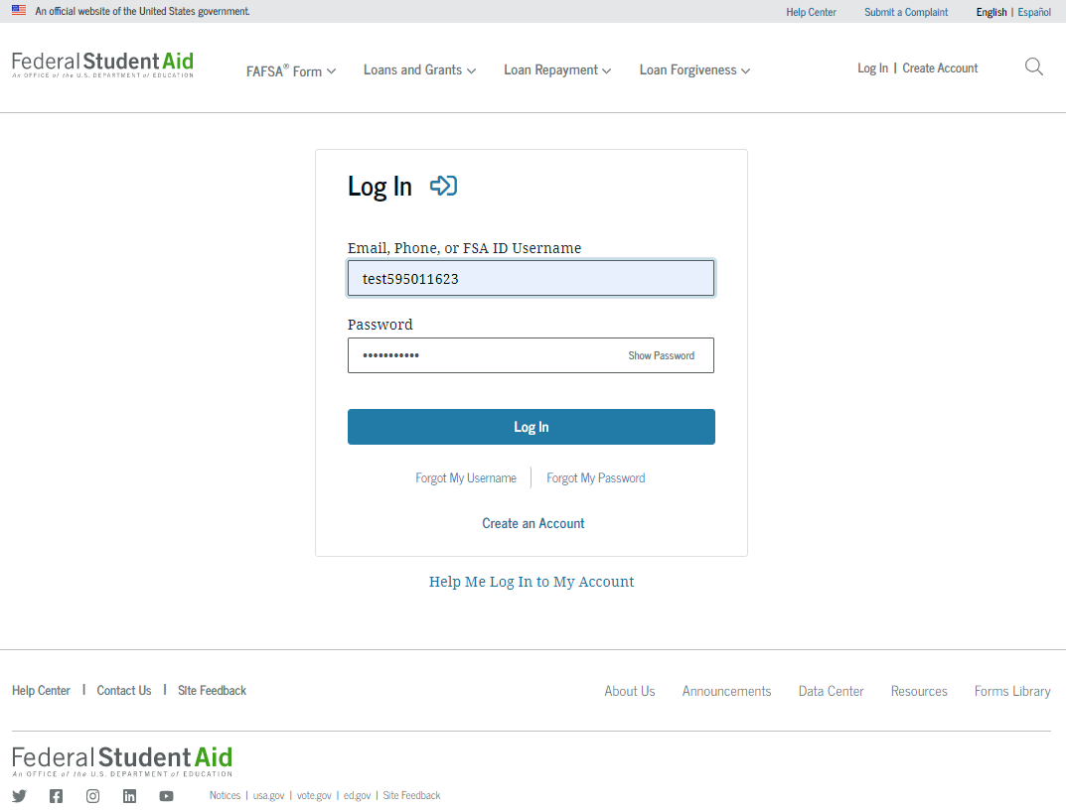
Dependent Student’s Parent Log In
The parent is taken from their email to the “Log In” page to enter their log-in credentials. To access the FAFSA® form, all users are required to have an FSA ID (account username and password). If the parent doesn't have an FSA ID, they can select "Create an Account."

Slide 47
Parent Status Center – My Activity
After successfully logging in, the parent is taken to their “My Activity” page. The parent sees an invitation to be a contributor on the student’s FAFSA® form.

Slide 48
Dependent Student’s Parent Contributing to the FAFSA® Form
This page provides information about being a contributor on a FAFSA® form.

Slide 49
Dependent Student’s Parent Onboarding (1 of 4)
When the parent enters a 2024–25 FAFSA® form for the first time, they are taken through the FAFSA onboarding process. The first onboarding page provides an overview of the FAFSA form and an accompanying video.

Slide 50
Dependent Student’s Parent Onboarding (2 of 4)
The second FAFSA® onboarding page provides information about the different roles that may be required to complete the student’s FAFSA form and the documents that may be needed to fill out the form.

Slide 51
Dependent Student’s Parent Onboarding (3 of 4)
The third onboarding page provides information about the types of questions the parent can expect to see and how they can get help in filling out the FAFSA® form.

Slide 52
Dependent Student’s Parent Onboarding (4 of 4)
The last onboarding page provides information about what to expect once the FAFSA® form is completed and submitted. On this page, the parent selects "Start the FAFSA form" to begin the parent section.

Slide 53
Dependent Student’s Parent Identity Information
This is the first page within the parent section. The parent can verify that their personal information is correct. To update any of the personal information, the parent must access their Account Settings on StudentAid.gov. For fields related to the parent’s mailing address, the parent can edit them directly on this page.

Slide 54
Dependent Student’s Parent Identity Information (Continued)

Slide 55
Dependent Student’s Parent Provides Consent
This page informs the parent about consent and their federal tax information. By providing consent, the parent’s federal tax information is transferred directly into the FAFSA® form from the IRS to help complete the Parent Financials section. The parent selects "Approve" to provide consent and is taken to the next page.

Slide 56
Dependent Student’s Parent Provides Consent (Continued)

Slide 57
Introduction: Dependent Student’s Parent Demographics
This is the first page in the Parent Demographics section. It provides an overview of the section.

Slide 58
Dependent Student’s Parent Current Marital Status
The parent is asked about their current marital status. They select the "Married (not Separated)" option.

Slide 59
Dependent Student’s Parent State of Legal Residence
The parent is asked about their state of legal residence. The parent selects the state from a dropdown box and provides the month and year when they became a legal resident.

Slide 60
Introduction: Dependent Student’s Parent Financials
This is the first page within the Parent Financials section. It provides an overview of the section.

Slide 61
Dependent Student’s Parent Federal Benefits Received
This page asks the parent if they or anyone in their family has received federal benefits. The parent selects "None of these apply."

Slide 62
Dependent Student’s Parent Tax Filing Status
This page asks the parent about their tax filing status. The parent selects "Yes" to "Did or will the parent file a 2022 joint tax return with their current spouse?"

Slide 63
Dependent Student’s Parent Family Size
This page asks the parent if their family size has changed. The parent selects the “Yes“ option.

Slide 64
Dependent Student’s Parent Number in College
This page asks the parent how many people in the family will be in college between July 1, 2024, and June 30, 2025. The parent enters a response into the entry field.

Slide 65
Dependent Student’s Parent Tax Return Information
The parent is asked questions about their 2022 tax return. The parent enters a response in each entry field.

Slide 66
Dependent Student’s Parent Assets
The parent is asked about their assets. The parent enters a response in each entry field.

Slide 67
Dependent Student’s Other Parent Information
The parent is asked to provide information about their spouse or partner.

Slide 68
Dependent Student’s Parent Review Page
The review page displays the responses that the parent has provided in the FAFSA® form. In this scenario, the parent can only view responses within the parent section of the student’s FAFSA form. The parent can view all their responses by selecting "Expand All" or expand each section individually. To edit a response, the parent can select the question’s hyperlink to be taken to the corresponding page.

Slide 69
Dependent Student’s Parent Signature
On this page, the parent acknowledges the terms and conditions of the FAFSA® form and signs their section. Since all required sections are complete, the parent can both sign and submit the student’s FAFSA form.

Slide 70
Dependent Student FAFSA® Confirmation
Upon submitting the student’s FAFSA® form, the parent is presented an abbreviated confirmation page. This page displays information about tracking the student’s FAFSA form and next steps. The student will receive an email with the full, detailed confirmation. With the student and parent sections completed and signed, the FAFSA form is now considered complete and submitted for processing.

Slide 71
Parent Starts and Submits a FAFSA® Form Without Student Consent or Signature

Slide 72
Parent FAFSA® Form Landing Page
This is the main FAFSA® form landing page. On this page, students and parents are directed to "Start a New Form" or "Edit Existing Form." For the purpose of this presentation, the parent is beginning a new application on behalf of their child.

Slide 73
Parent Log In
If the parent selects "Start a New Form" from the FAFSA® landing page and they are not logged in to StudentAid.gov, they are taken to the "Log In" page to enter their log-in credentials. To access the FAFSA form, all parents are required to have an FSA ID (account username and password). If the parent doesn't have an FSA ID, they can select "Create an Account."​

Slide 74
Parent Roles
After logging in, the parent selects the applicable role to fill out the FAFSA® form: "Parent."

Slide 75
Parent’s Student Information
The parent is asked to provide the student’s information. Since the student has not started a FAFSA® form yet, they will receive an email notifying them that a FAFSA form was started on their behalf. The student can then enter the form to provide consent, sign the form, and make any needed corrections.

Slide 76
Parent’s Student Information (Continued)

Slide 77
Parent Onboarding (1 of 4)
When the parent starts the 2024–25 FAFSA® form for the first time, they are taken through the FAFSA onboarding process. The first onboarding page provides an overview of the FAFSA form and an accompanying video.

Slide 78
Parent Onboarding (2 of 4)
The second FAFSA® onboarding page provides information about the different roles that may be required to participate in the student’s FAFSA form and documents that may be needed to fill out the form.

Slide 79
Parent Onboarding (3 of 4)
The third FAFSA® onboarding page provides information about the types of questions the parent can expect to see and how they can get additional help with filling out the FAFSA form.​

Slide 80
Parent Onboarding (4 of 4)
The final FAFSA® onboarding page provides information about what to expect once the FAFSA form is completed and submitted. On this page, the parent can select "Start the FAFSA form" to begin.

Slide 81
Parent’s Student Identity Information
After starting the FAFSA® form, the parent sees the first page within the student section. The parent can verify that the student’s personal information is correct. To update any of the personal information, the student must access their Account Settings on StudentAid.gov. For fields related to the student’s mobile phone number and mailing address, the parent can edit them directly on this page.

Slide 82
Parent’s Student Identity Information (Continued)

Slide 83
Parent’s Student State of Legal Residence
The parent is asked about the student’s state of legal residence. The parent selects the state from a dropdown box and provides the month and year when the student became a legal resident.

Slide 84
Introduction: Parent’s Student Personal Circumstances
This is the first page within the Student Personal Circumstances section. It provides an overview of the section.

Slide 85
Parent’s Student Marital Status
The parent is asked about the student’s marital status. The parent selects the "Single (Never Married)" option.

Slide 86
Parent’s Student College or Career School Plans
The parent is asked about the student’s college grade level for the 2024–25 school year and if the student will have their first bachelor’s degree. The parent selects that the student will be a "First Year (freshman)" and that they will not have their first bachelor’s degree.

Slide 87
Parent’s Student Personal Circumstances
The parent is asked if any of the listed personal circumstances apply to the student. The parent selects the "None of these apply" option.

Slide 88
Parent’s Student Other Circumstances
The parent is asked if the student was homeless or at risk of being homeless. The parent selects "No."

Slide 89
Parent’s Student Unusual Circumstances
The parent is asked if unusual circumstances prevent the student from contacting their parent(s). The parent selects "No."

Slide 90
Parent’s Student Dependency Status: Dependent Student
Based on the answers provided by the parent, the student is considered a dependent student. The parent is asked if they want a financial aid administrator to determine the student’s eligibility for a Direct Unsubsidized Loan only. This is an option if they are unwilling to provide their information. The parent selects "No."

Slide 91
Parent Identity Information
This is the first page within the parent section. The parent can verify that their personal information is correct. To update any of the personal information, the parent must access their Account Settings on StudentAid.gov. For fields related to the parent’s mailing address, the parent can edit them directly on this page.

Slide 92
Parent Identity Information (Continued)

Slide 93
Parent Provides Consent
This page informs the parent about consent and their federal tax information. By providing consent, the parent’s federal tax information is transferred directly into the FAFSA® form from the IRS to help complete the Parent Financials section. The parent selects "Approve" to provide consent and is taken to the next page.

Slide 94
Parent Provides Consent (Continued)

Slide 95
Introduction: Parent Demographics
This is the first page in the Parent Demographics section. It provides an overview of the section.

Slide 96
Parent Current Marital Status
The parent is asked about their current marital status. They select the "Single (Never Married)" option.

Slide 97
Parent State of Legal Residence
The parent is asked about their state of legal residence. The parent selects the state from a dropdown box and provides the month and year when they became a legal resident.

Slide 98
Introduction: Parent Financials
This is the first page within the Parent Financials section. It provides an overview of the section.

Slide 99
Parent Federal Benefits Received
This page asks the parent if they or anyone in their family has received federal benefits. The parent selects "None of these apply."

Slide 100
Parent Family Size
This page asks the parent if their family size has changed since filing their 2022 tax return. The parent selects the "No" option.

Slide 101
Parent Number in College
This page asks the parent how many people in the family will be in college between July 1, 2024, and June 30, 2025. The parent enters a response into the entry field.

Slide 102
Parent Tax Return Information
The parent is asked questions about their 2022 tax return. They enter a response in each entry field.

Slide 103
Parent Assets
The parent is asked about their assets. They enter a response in each entry field.

Slide 104
Parent Review Page
The review page displays the responses that the parent has provided in the previous student and parent sections of the student’s FAFSA® form. The parent can view all their responses by selecting "Expand All" or expand each section individually. To edit a response, they can select the question’s hyperlink to be taken to the corresponding page.

Slide 105
Parent Signature
On this page, the parent acknowledges the terms and conditions of the FAFSA® form and signs their section. After agreeing and signing, the parent is able to submit their section of the FAFSA form. Since the student section is incomplete, the FAFSA form is not considered complete and can’t be processed yet. ​

Slide 106
Parent Section Complete
Upon signing the parent section, the parent is presented the parent section complete page. This page displays information for the parent about next steps, including tracking the student’s FAFSA® form. The parent is reminded that the student’s form is not complete and can’t be processed until the student section is complete. Next, in this scenario, the parent selects “Provide Student Information Manually" and enters the student section.
This screenshot is currently unavailable. It will be available in a future preview presentation scheduled for December 2023.

Slide 107
Introduction: Parent’s Student Demographics
This is the first view within the Student Demographics section. It provides an overview of the section.

Slide 108
Parent’s Student Demographic Information
The parent is asked about the student’s gender identity and if the student is transgender. The parent selects a response from the options for both questions.

Slide 109
Parent’s Student Race and Ethnicity
The parent is asked if the student is of Hispanic, Latino, or Spanish origin. They are also asked about the student’s race. The parent selects checkboxes to answer both questions.

Slide 110
Parent’s Student Citizenship Status
The parent is asked about the student’s citizenship status. The parent selects the "U.S. citizen or national" option.

Slide 111
Parent Education Status
The parent is asked about their education status. They select the "No" option.

Slide 112
Parent Killed in Line of Duty
The parent is asked if the student's parent or guardian was killed in the line of duty. The parent selects the "No" option.

Slide 113
Parent’s Student High School Completion Status
The parent is asked what the student’s high school completion status will be when they start the 2024–25 school year. The parent selects the "High school diploma" option.

Slide 114
Parent’s Student High School Information
The parent is asked which high school the student did or will graduate from. The parent enters the student’s high school’s state and city. After selecting "Search," they select the correct high school from the search results. ​

Slide 115
Parent Confirms High School
The parent is asked to confirm the high school information. By selecting "Edit," they will return to the high school information page. The parent verifies the student’s high school information and selects "Continue" to proceed to the next section.

Slide 116
Introduction: Parent’s Student Financials
This is the first page within the Student Financials section. It provides an overview of the section.

Slide 117
Parent’s Student Tax Filing Status
This page asks the parent about the student’s tax filing status. The parent selects "Yes" to "Did or will the student file a 2022 IRS Form 1040 or 1040-NR?"

Slide 118
Parent’s Student Tax Return Information
Since the student has not provided consent for their federal tax information to be transferred directly into the FAFSA® form, the parent is asked to manually enter the student’s 2022 tax return information. The parent enters a response in each entry field. ​
This screenshot is currently unavailable. It will be available in a future preview presentation scheduled for December 2023.

Slide 119
Parent’s Student Assets
The parent is asked about the student’s assets. The parent enters a response in each entry field.

Slide 120
Introduction: Parent Select Colleges
This is the first page in the Select Colleges section, which is the final part of the FAFSA® form’s student section to require information. It provides an overview of the section.

Slide 121
Parent College Search
The parent is asked to search for the colleges and/or career schools they would like to receive the student’s FAFSA® information. The parent searches for a school by entering a state, city, and/or school name. After selecting "Search," they select the correct school from the search results. Parents can select to send the student’s FAFSA information to a maximum of 20 schools.

Slide 122
Parent College Search (Continued)

Slide 123
Parent Selected Colleges
The parent can view which colleges and/or career schools they have selected for the student. If the parent has not selected 20 schools, they have the option to search and select more schools, and, in some states, they have the option to change the position of their selected schools. When the parent selects "Continue," they will have completed entering the required student information for the student section and can proceed to the review page.

Slide 124
Parent Selected Colleges (Continued)

Slide 125
Parent’s Student Review Page
The review page displays the responses that the parent has provided in the FAFSA® form on behalf of the student. The parent can view all the responses by selecting "Expand All" or expanding each section individually. To edit a response, the parent can select the question’s hyperlink and will be taken to the corresponding page. The parent cannot provide a signature for the student.

Slide 126
Parent’s Student Section Complete
The parent is presented the student section complete page. This page displays information for the parent about next steps, including tracking the student’s FAFSA® form. Because the student’s consent and signature are missing, the student is currently ineligible for federal student aid, including grants and loans. The student must enter their form, provide consent and signature, and submit the student section for their FAFSA form to be processed.

Slide 127
Conclusion

